Slide 1
Team B: Tetris Game
Members: Andrew Oneal, Bryce Bien, Spencer Yates
1

Slide 2
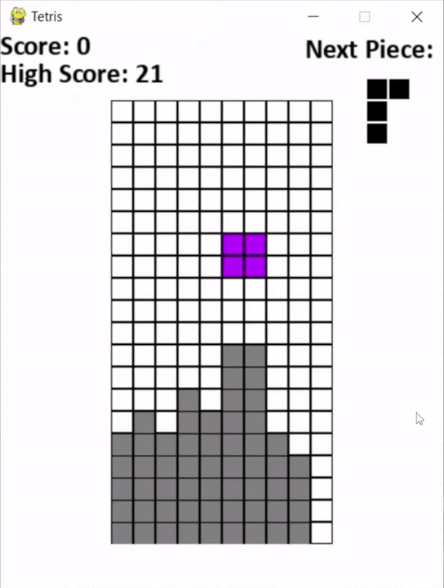
The Base
The hit game Tetris
2

Slide 3
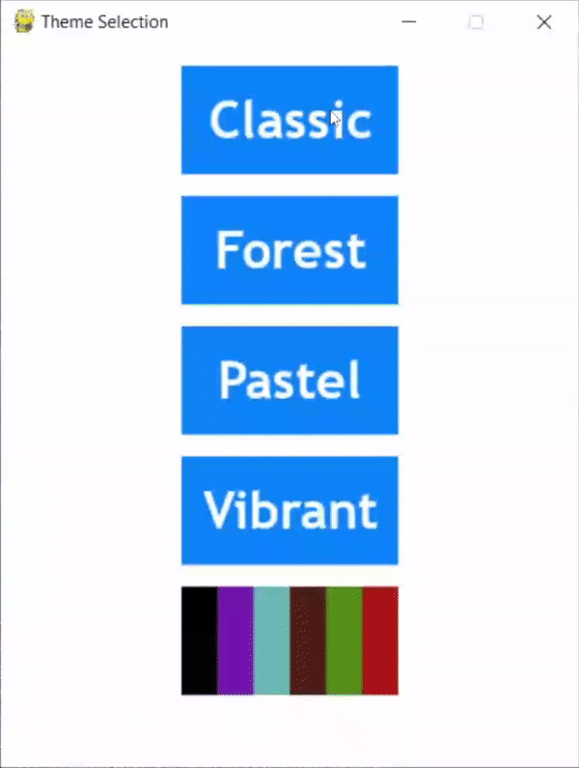
Themes
Created by: Andrew
Multiple unique themes
Theme preview screen
3

Slide 4
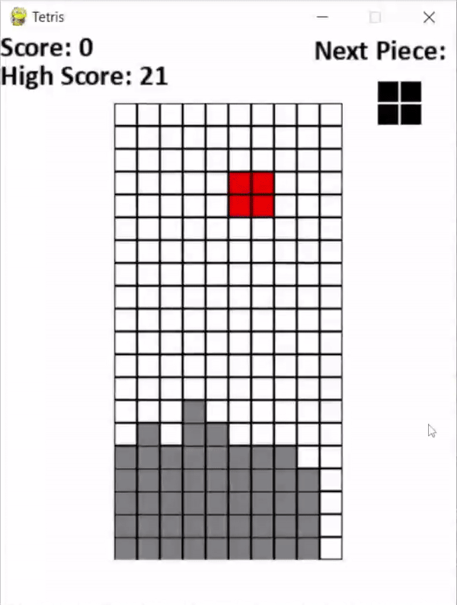
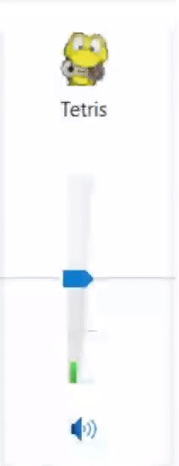
Sound Effects + Background Music
Created by: Andrew
Sound effects for actions
Music playing throughout the game
4

Slide 5
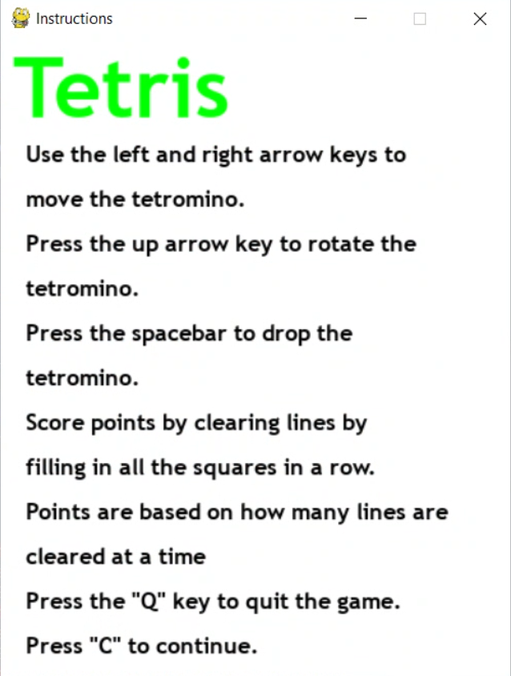
Tutorial Menu
Created by: Andrew
Explains how to play
5

Slide 6
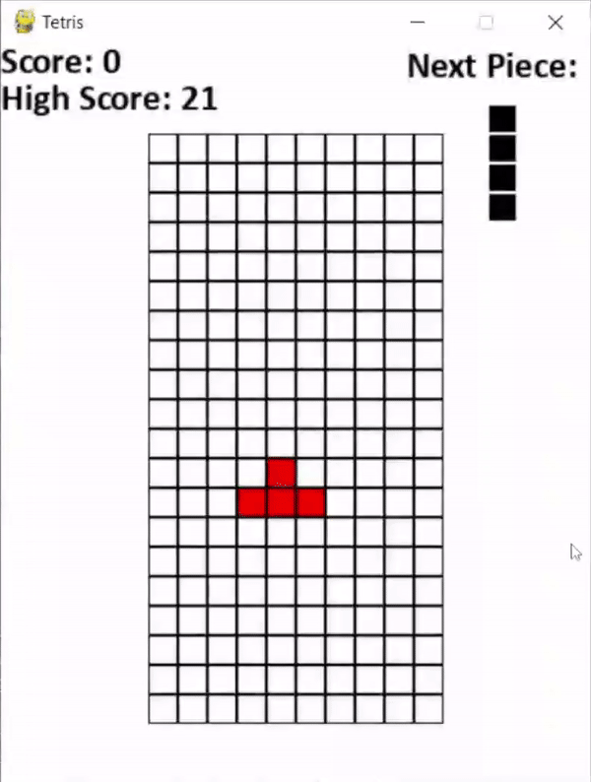
Change frozen block color
Created by: Bryce
Tetris pieces freeze when locked
Provides clear indicator
6

Slide 7
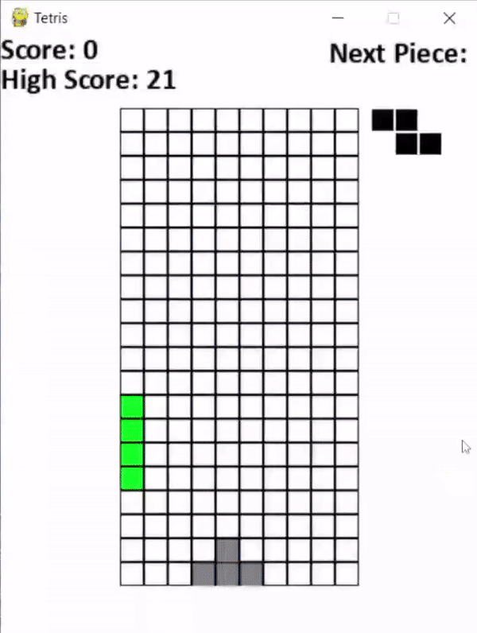
Show next piece
Created by: Bryce
Selects next piece ahead of time
Display in top right
7

Slide 8
High Score
Created by: Bryce
Records your highest score
Updates in real time
8

Slide 9
Lines of Code
Starting 188
Ending 634
9

Slide 10
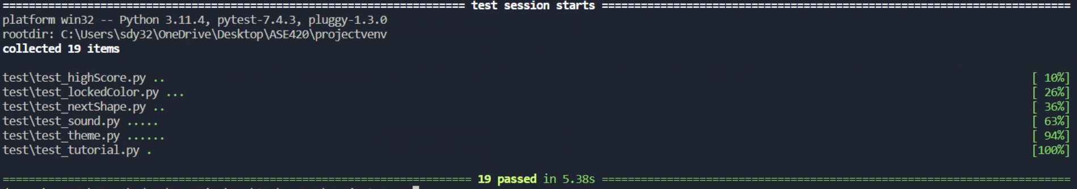
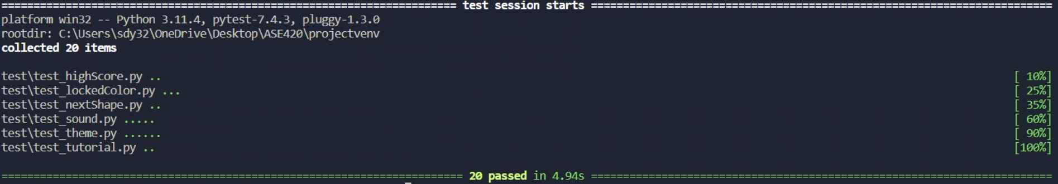
Test Coverage
At least 2 unit tests per feature
2 integration tests
6 acceptance tests
20 tests total
10

Slide 11
What we learned
How to identify and refactor code smells
How to use design patterns effectively to build and design our code
Work in an environment that simulates that of the workplace
11

Slide 12
Questions?
12

